Slide 1
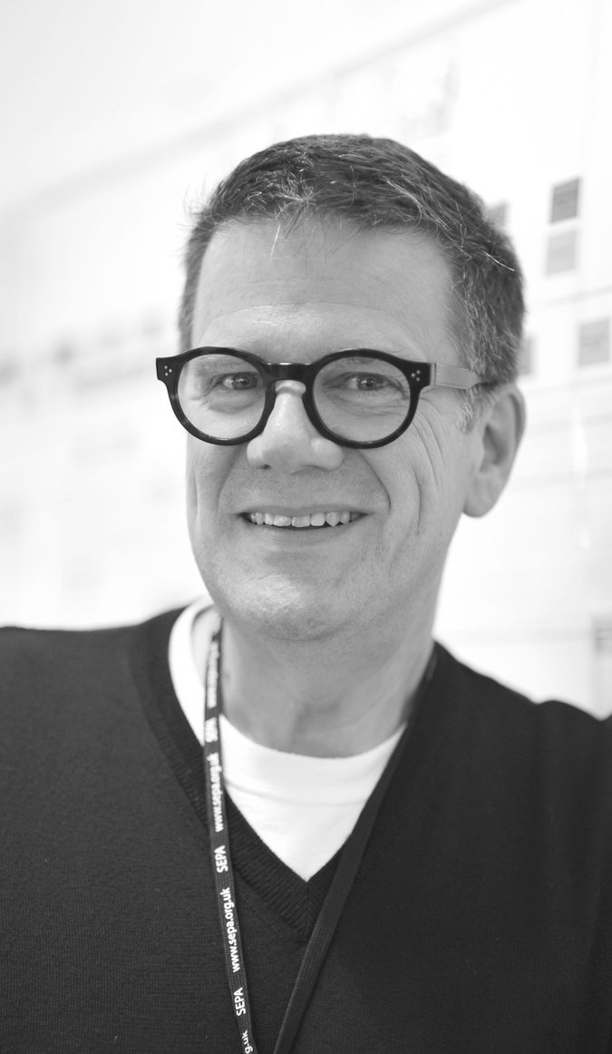
8
Dug Falby
Strategic Design Director
London
About
Skills
Design Thinking
Business design consulting
Service Design
Design Research
Co-creation and facilitation - Training and capability-building
Design leader with over 16 years experience guiding and mentoring product and digital transformation teams in both client and consultancy-side roles
As Strategic Design Director in the Designit London studio, Dug has an overview on all client projects and pays special attention to service design strategy and approach, capability building and helping the design community to fulfil their potential.
In previous roles he was CX Director in the turnaround team at Dixons Stores Group and built Accenture’s London experience-led digital transformation practice.
Dug was tapped as a BIMA100 in service design consulting and sits on the advisory board of the New Breed innovation network.
Landmark clients
Irish Department for Social Protection
Coca-Cola Entreprises
Defra
BBC Advertising
Diageo
HMRC
Friends Provident
Aegis

